Slide 1
From Idea to Implementation: DevOps Enabled Agile Transformation
Jon Harding, BankofAmerica.com Operations Lead
@jth6528
#DOES15
Jon.harding@bankofamerica.com
October 20, 2015
Notes:
Thank you for making the long walk to Bayview B, it is not easy to find.
Southern Fried Agile, Southern Food association
Read the Slide

Slide 2
Disclaimer: The views expressed are mine and do not necessarily reflect the views of Bank of America or its customers and clients.
Notes:
Read the Disclaimer

Slide 3
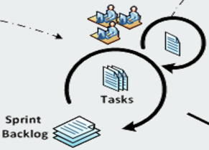
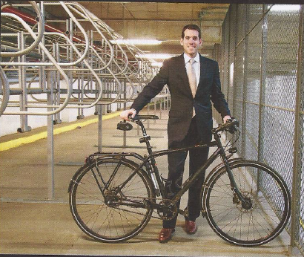



About Me
10+ Years Banking and Finance IT Experience
18 Years Enterprise Systems Development, IT Operations, and Consulting
Agile Change Agent
Father of 3 Great Dudes and a Little Lady
Bike Advocate and Athlete
Notes:
NCAA Academic All American and that experieince informs how I build teams, and set goals.
My family means a lot to me. Asside: Oldest son loves minecraft, mod eco-system is a nightmare of undocumented, untested code.
Charlotte is a small city with 2 large Avenues and 10 cross streets with 2 big banks.
Support Bank of America’s Online Servicing and Sales environment.
31 million online banking users / 3 million unique visitors to BofA.com daily
Support 10s of thousands of new accounts online and in banking centers monthly
Checking and Savings Accounts
Credit Cards / Instant Credit
Auto Loans
HELOC

Slide 4
Agenda
Problem we are trying to Solve:
Deliver High- Scale, High-Value consumer facing web software Rapidly using Agile methods
Where did we start?
Agile! 2 week sprints! Co-Location. Dev + Test together.
Let’s Talk About 3 things:
Has DevOps Jumped the Shark ? Let’s try again to define it, and why you can’t do Enterprise Agile without it
Alan Zeichik
2. The Core Elements of IT Management and DevOps
3. Our model of a working DevOps tool chain, highlighting how tool capabilities aligns with Agile principles
Results
Notes:
Organizational challenges of Legacy BofA:
6 Sigma Organization, Project is the only vehicle to make change, Integrated release
Where did we start?
Slashdot: DevOps: Threat or Menace ?
No, but as practitioners we need to be aware of the buzz-life half-live
OK, that’s 4, but we can do this right ?

Slide 5
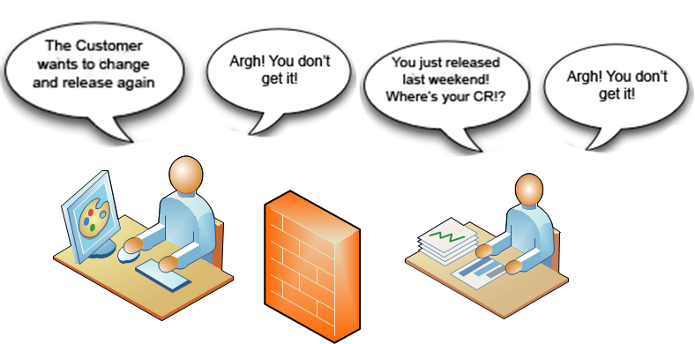
DevOps Ethos and Admitting We Have a Problem
Development + I/T Operations = DevOps
Principles come from Enterprise Systems Management and Agile Development
Reduces waste and Focuses developers and testers by automating - maximizing code turns.
Imperative for Agile success
Tools! … enabling communication and collaboration between groups…and tracability.
Notes:
People Think Automation and Tools when DevOps is referenced. Doesn’t help …Gear Heads… DevOps is the realization that we have a problem in enterprise IT:
Raise your hand if this sounds familiar:
Endless Conference Calls all day long and an Outlook calendar that goes 3 wide all day Weekend Release war rooms.
Coming back from vacation to 500, 5000, 50,000 e-mails ?
Meeting a team member face to face for the first time…
Agile and DevOps are a response to... designed by the defense industry and refined by finance managers.
Agile says no, Software creation is more than just a process, it’s an art form…not fungible
DevOps and embedded DevOps adds that a software team should have control over their destiny and they should have the best tools to perform their craft. They should have control of their work from idea to implementation. Culture ….Ethos
Focuses not abstracts:
Reduces wastes
Increases Velocity
Imperative:
Graphic: Competing priorities. Serve the business
Development: Frequent Change will get it right Operations : Stability , reduced change
Agile principles:
Frequent Delivery
Collaborative work estimation
Equal partners working with the business
Favorite: Bringing craftsmanship back into Software
Build around motivated people, and trust them
Sustainable work life balance
Attention to technical excellence
What does this have to do with DevOps?
Enhanced Craftmanship & Tools
Complete Team – control of our own destiny.
Tools

Slide 6
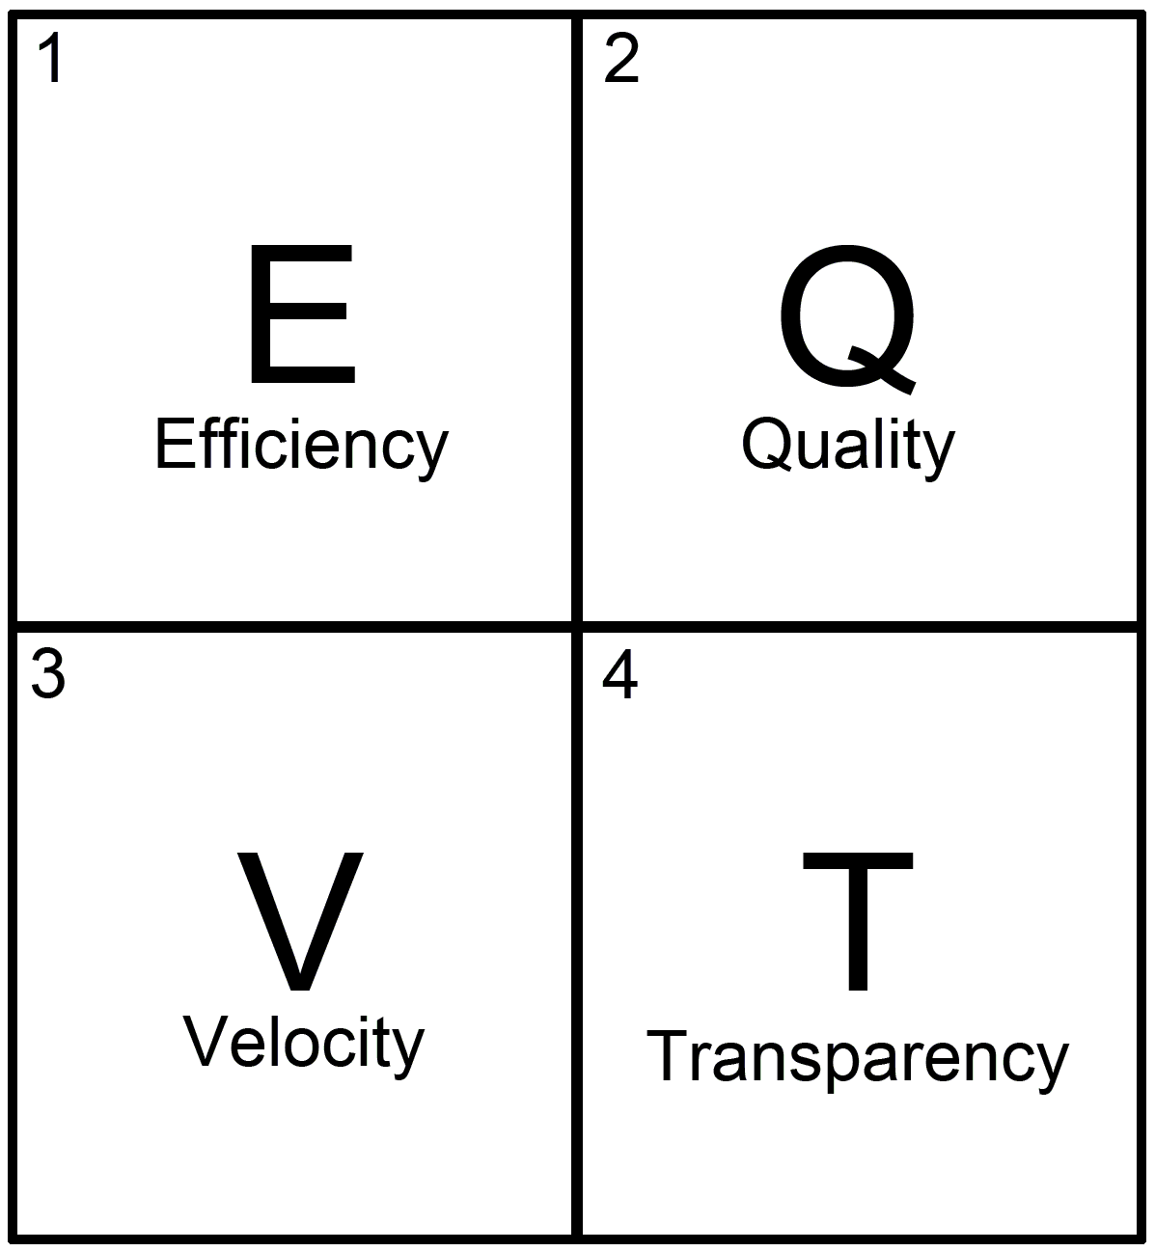
Periodic Table of Core IT Elements
Process Efficiency –
Software Quality –
Agile Lifecycle Velocity –
Change Transparency –
Notes:
Periodic Table of IT Management Elements
Core Elements can construct justification or ROI reasonable project.
Let’s use Embedded DevOps as an example:
Efficiency:
2 cases
Efficiency of scale – transitioning the responsibility for commodity process to a centralized group…within reason. Must maintain accountability.
SDLC Automation – Using a DevOps tool chain for SDLC functions: Build, Deploy, Test
Quality:
SDLC Automation ensures testing is happening as code is changing.
Automate as much as you possible can. Compile, unit test, deployment, regression testing, security scanning, code standards scanning,
Shifting defect exposure left. (Site the cost of a defect.) Velocity: Creating great software is about the back and forth: Business, Architecture, Development, UI, Testing, Operations. Speed up the communication, make it more clear, and make it more traceable. Transparency:
It’s all about the 4 W’s Who did:
What , Where , When , and Why

Slide 7
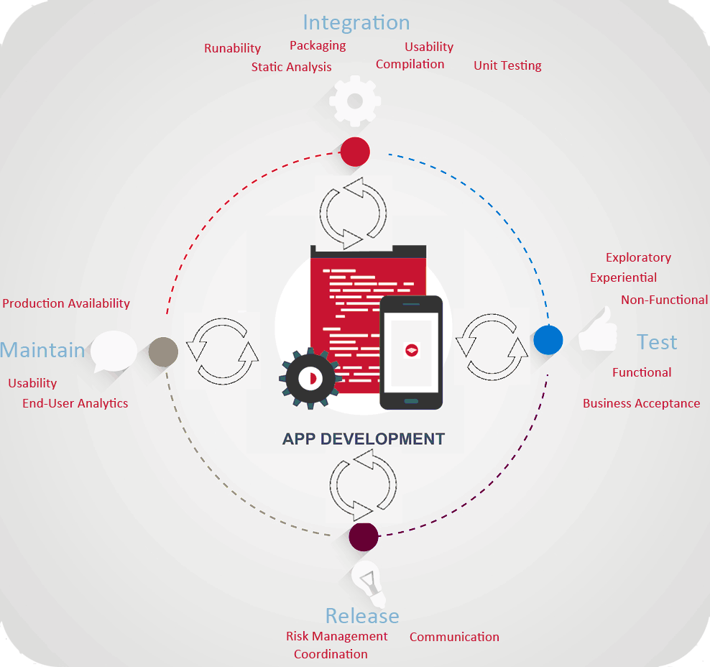
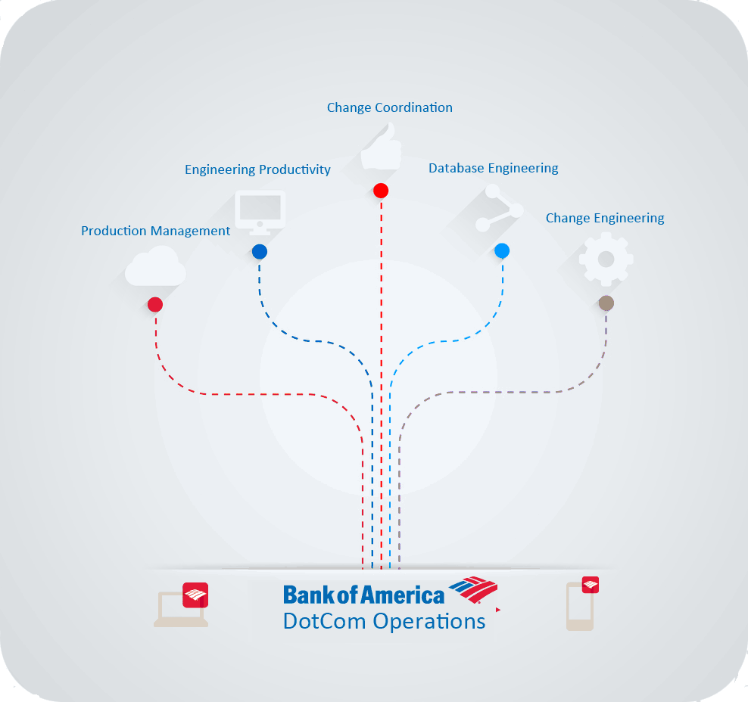
DevOps Ethos Team Structure/ Core Functions
Notes:
Bank of America.com Operations Team: DevOps Ethos permeates through all of these teams.
Serve Delivery
Improve Quality
Make life better How are all of these functions DevOps ? Production Support:
Monitoring production app performance
End user feedback – There will be complaints !
App Availaiblity – Store front and bad impression
Engineering Productivity:
Code Quality Tools (Static analysis, security scanning)
Compliance: BofA has literaly thousands of applications. Change Coordination:
Sweat the small stuff….Manage the risk, and make sure I’s dotted T’s crossed
DB Engineering
Provide Persistence expertise. NoSQL, MySQL, what have you. This team brings shareable DB architecture, design, and administration experience.
Change Engineering:
SDLC Automation , Build, Deployment, Test Automation, and Separation of Duties.
All of these teams promote DevOps. Every time I get called about a director of Devops role, I want to tell the recruiter no thanks this company is missing the point.
All of those teams map to these core SDLC functions increasing development efficiency and providing feedback to the team to make a better product. Code Integration: Bringing everyone’s work together when story development is done.
Testing: Manual, automated, non-functional Release: Manage the risk of change Maintain: What is the customer actually experiencing?

Slide 8
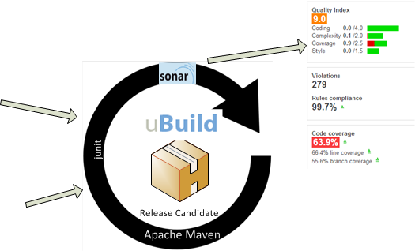
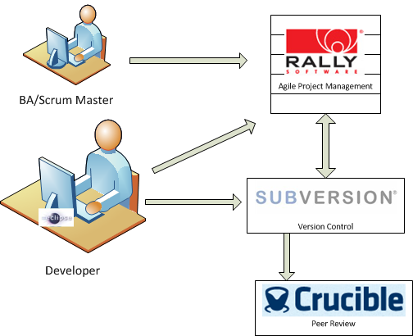
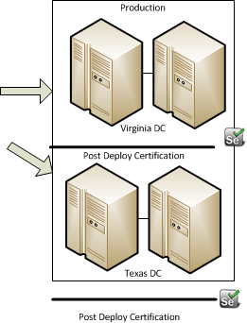
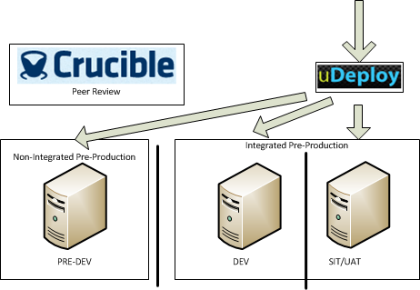
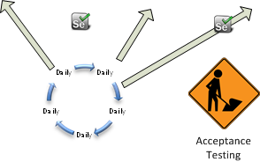
DevOps Tool Chain: Enabling Enterprise Agile from Idea to Implementation
Compile, Test, Scan, and Package
Define and Develop
LLE Deploy
Deploy
Test, Measure, Test, Repeat
Release
Notes:
Define: Capture all meta data about the change in Rally using their great Work Taxonomy of Initiative, feature, story, task, defect, and test case. All source code commits are associated with work items in Rally by convention, and can be reported on. In other words you can produce reports that show every work item included in a production release, or differences in two daily deploys to DEV. Crucible
* Promotes the idea that all work should be visible
Integrate: Build Once and Deploy Many Times – * Working Software is the primary measure of progress. Continuous Attention to technical Excellence. Hard to sprint…
Deploy:
Common Deployment Workflow for all environments – promotes process quality
Test: Scheduled automated regression testing running hundreds of test cases with thousands of data variation. Browser testing, performance testing manual testing for each user story and for regression. Exploratory. Release No more plug and pray events and weekend war rooms. Should get an e-mail on your phone at 5:10 that deployments complete and support teams will be monitoring over the weekend.

Slide 9
Business Results 2013 - 2015
Jan 2013
Complete Redesign of On-Line Deposits Products Sales
Nov 2013
Operational Efficiency via BPM automation and Straight-Through Fulfillment
August 2014
Responsive UI Redesign for Consumer Deposits Sales Flow
November 2014
Awarded Forrester #1 online banking sales experience for
August 2015
Responsive Redesign for Consumer Credit Card Sales Process
“We are a continuum of value-adding software delivered to production with great predictability driving the Digital Sales & Marketing and Fulfillment Operations businesses.”
Notes:
Jan 2013 Complete re-platform of the deposits purchasing application.
100K lines of code
It was a mess, but it was ours, and we had no where to go but up.
Took us 5 subsequent break-fix deployments just to get it stable.
No where to go but up.
Nov 2013: First release of Account Opening Back ends
Deposit Fulfillment reduced from 3 days to 3 hours
August 2014: Responsive Redisign for deposit applications
24% Sales Increase within Weeks
November 2014: Awarded best account opening experience by forester:
Think about that….Citi Group, JP Morgan, Wells Fargo (ahem), ours is the best
August of this year:
31% YOY Growth in Digital Sales
Represents 17% of all new accounts – We are becoming the face of the bank…..people don’t want to go into banking centers.

Slide 10
Technology Results 2013 - 2015
+500% E
+ Increase in all deployments helping to move stories down the board.
-75% Q
Year 1 reduction in Sev 1 or 2 Defects.
+25% V
Year 1 Increase in development velocity as measured by story points
100% T
2 Large scale Audits of the On-Line Banking Plat form passed in 2013 and 2015.
Notes:
Back to our Core Elements: How did we do ?
Went from 10 Lower level deployments to 50, and 3-4 prod release to monthly
Quality:
75% reduction in serous production defects in year 1.
Velocity:
In year 1 our average sprints per story point went from ~50 to 63

Slide 11
Top 5 Takeaways
Words matter, so let’s be mindful as practitioners of the half-life of DevOps buzzword half-life
DevOps != (only)Tools
Enterprise Agile (Fortune 1000) can not happen without DevOps tools and roles.
Enterprise Agile + DevOps can bring humanity, sustainable work/life, and motivation to team members.
DevOps is an ethos that can span all horizontal technical functions that have the common elements of

Slide 12
Here’s what I’m looking for help with
How to measure group and deliver value via continuous delivery.
Notes:
Waited Shorted Job First for intake, but what do we have for out-put?

Slide 13
Questions and Answers
?...
@jth6528
Jon.Harding@bankofamerica.com
#DOES15

